Slide 1




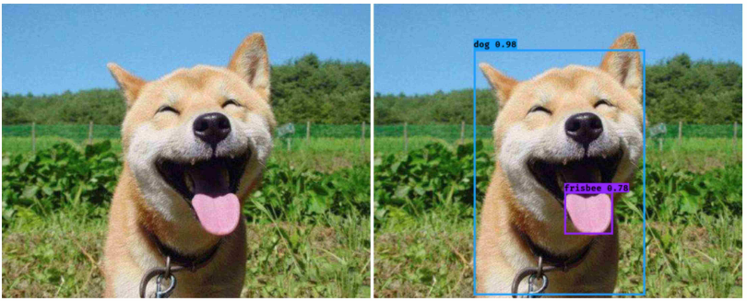
2
0
1
4
Focal Loss for Dense Object Detection
》》
舒文婷
26/11/8

Slide 2
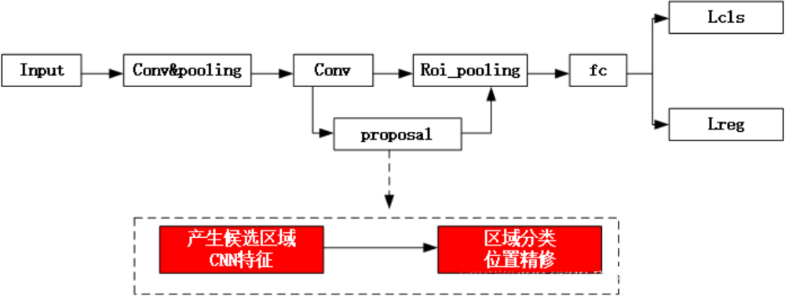
two stage：R-CNN, Fast R-CNN, Faster R-CNN，Mask R-CNN
Two-stage Detectors:the first stage generates a sparse set of candidate proposals that should contain all objects while filtering out the majority of negative locations, and the second stage classifies the proposals into foreground classes / background

Slide 3
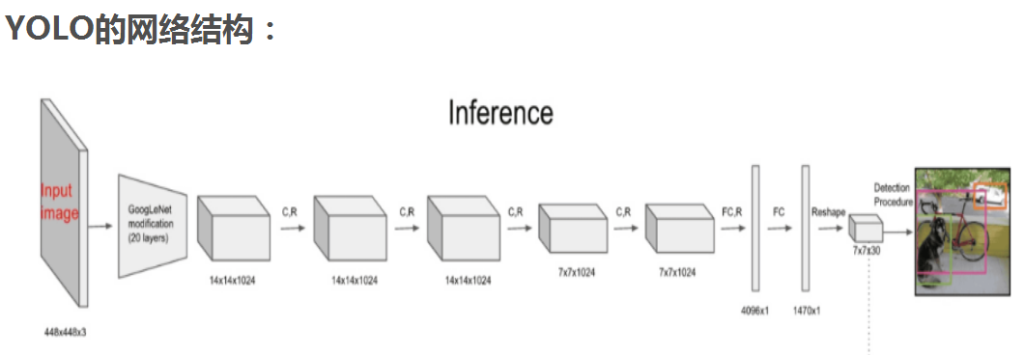
one stage ：YOLO，SSD，YOLOv2，YOLOv3，Retina-Net
One stage 进一步把目标判定和目标识别两个步骤合二为一，直接对输入图像应用算法并输出类别和相应的定位，识别速度有了很大提升
《You Only Look Once: Unified, Real-Time Object Detection》

Slide 4
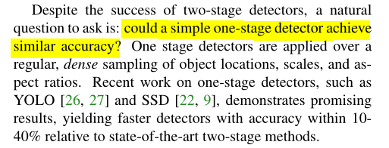
Why proposed focal loss

Slide 5
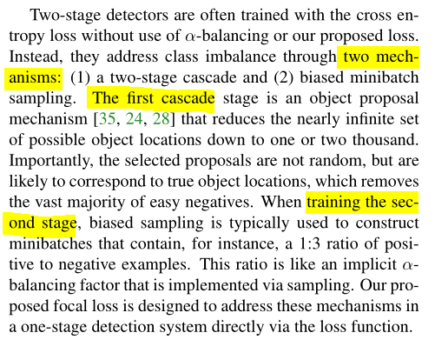
Two-stage detectors' class Imbalance

Slide 6
Class Imbalance
two stage | one stage
The proposal stage rapidly narrows down the number of candidate object locations to a small number, filtering out most background samples. In the second classification stage, sampling heuristics（启发式采样） are performed to maintain a manageable balance between foreground and background. | a one-stage detector must process a much larger set of candidate object locations regularly sampled across an image. In practice this often amounts to enumerating ∼ 100k locations that densely cover spatial positions,scales, and aspect ratios. While similar sampling heuristics may also be applied, they are inefficient as the training procedure is still dominated by easily classified background examples.
What will u do?

Slide 7

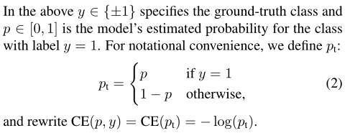
Focal loss
1.CE (Cross-entropy)
Balanced Cross Entropy

Slide 8
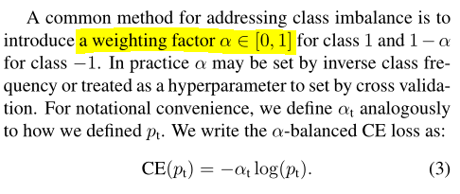
Focal loss
2.Balanced CE
Focal loss
While α balances the importance of positive/negative examples, it does not differentiate between easy/hard examples

Slide 9
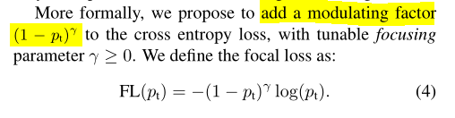
Focal loss
3.Focal loss
we propose to reshape the loss function to down-weight easy examples and thus focus training on hard negatives.

Slide 10

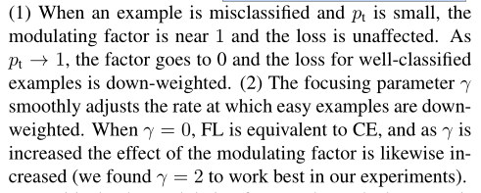
two properties of the focal loss
如: 当样本被分类错且Pt=0.1，则（1-Pt)^y趋于1，则与CE没什么区别;
当Pt=0.9,则（1-Pt)^y趋于0
当pt=0.9,y=2,
则（1-pt)^y=0.01
当Pt=0.9,y=0.5，
则（1-pt)^y=0.949

Slide 11
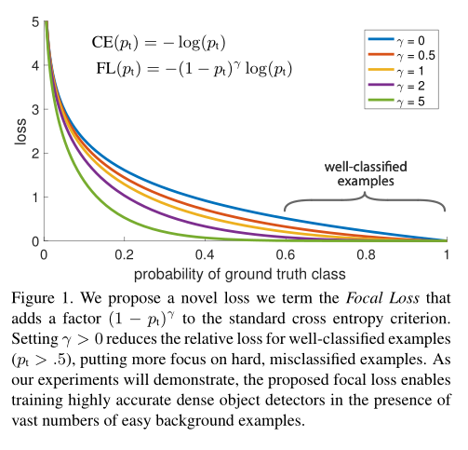
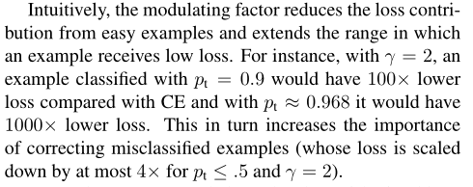
modulating factor
y=2,当 Pt = 0.1，(1-Pt)^y=0.81

Slide 12

Focal loss
4.Focal loss
positive/negative examples
easy/hard examples

Slide 13
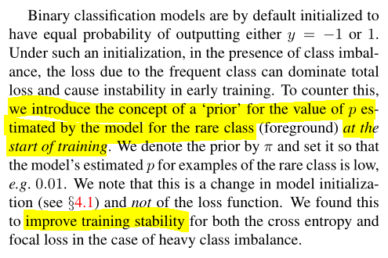
Model Initialization
For the final conv layer of the classification subnet, we set the bias initialization to b = −log((1 − π)/π), where π specifies that at the start of training every anchor should be labeled as fore-ground with confidence of ∼ π. We use π = .01 in all experiments,

Slide 14
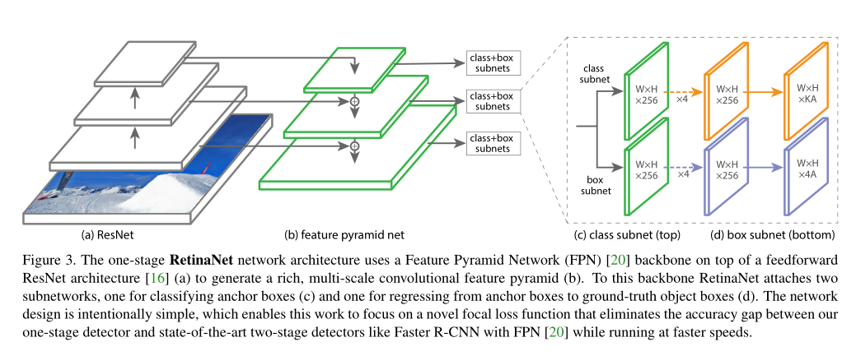
RetinaNet Detector
RetinaNet本质上是Resnet + FPN + 两个FCN子网络

Slide 15
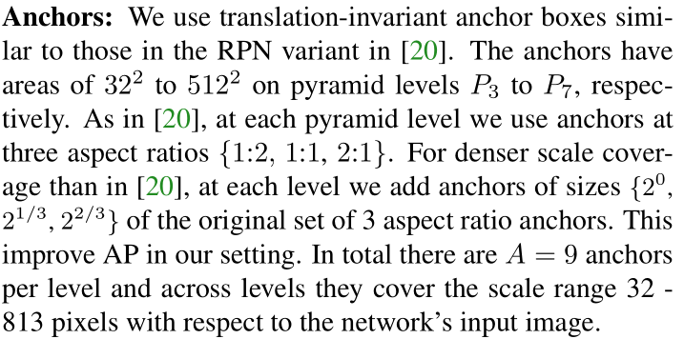
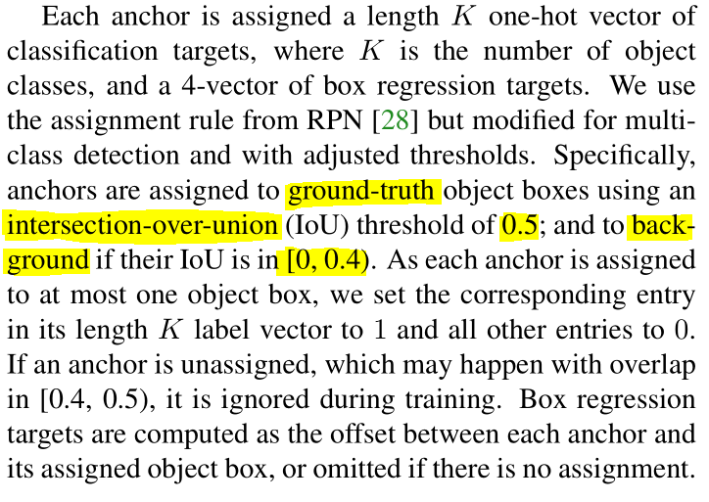
RetinaNet Detector
[20] Feature pyramid networks for object detection

Slide 16
RetinaNet Detector
Classification subnet:分类子网络在每个空间位置，为A个anchor和K个类别，预测object presence的概率。这个子网络是小的FCN（全卷积网络），与FPN中的每层相接；这个子网络的参数在整个金字塔的层间共享。设计方法是：如果一个从金字塔某个层里来的feature map是C个通道，子网络使用 四个3*3 的卷积层，C个滤波器，每个都接着ReLU激活函数；接下来用 3*3 的卷积层，有 KA 个滤波器。最后用sigmoid激活函数对于每个空间位置，输出 KA 个binary预测。作者用实验中 C=256 ，A=9 。与RPN对比，作者的object classification子网络更深，只用 3*3 卷积，且不和box regression子网络共享参数。作者发现这种higer-level设计决定比超参数的特定值要重要。
Box Regression subnet：与object classification子网络平行，作者在金字塔每个层都接到一个小的FCN上，意图回归每个anchor box对邻近ground truth object的偏移量。回归子网络的设计和分类相同，不同的是它为每个空间位置输出4A个线性输出。对于每个空间位置的A个anchor，4个输出预测anchor和ground-truth box的相对偏移。与现在大多数工作不同的是，作者用了一个class-agnostic bounding box regressor（不可知类的边框回归量），这样能用更少的参数更高效。Object classification和bounding box regression两个网络共享一个网络结构，但是分别用不同的参数。

Slide 17
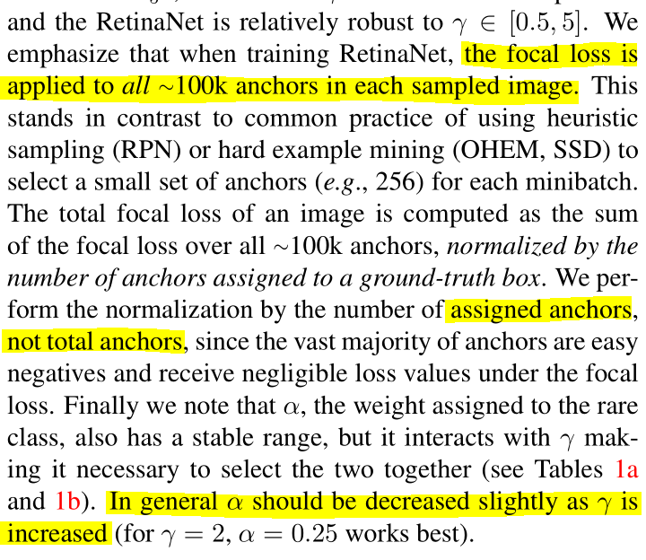
Inference and Training:Focal loss

Slide 18
谢谢观看

